Slide 1

Stochastic Process Algebras
Roland the Gunslinger
Turikpenova Zhibek 887820
Brahmashwini Regonda 887689

Slide 2

ABOUT PROJECT
In this presentation we give a simple examples of applying stochastic modelling techniques to model, which is based around a character called Roland Deschain.
We will consider the system in different scenarios, identify the components of interest and the activities which they undertake individually and in co-operation.
We will describe 3 cases: Roland meets an Enemy, Enemies fight back and Roland synchronize with a friend.

Slide 3
INTRODUCTION
Roland Deschain is a fictional character and the protagonist of Stephen King's The Dark Tower series.
Roland is a gunslinger and his life consists of wandering around firing his gun.
According to novel Roland is alone at the beginning of the series, following the way of ka, a variant of destiny. In the first novel, The Dark Tower: The Gunslinger, Roland's original desire is simply to climb to the Dark Tower's top to question whatever god dwells there, but ka has greater plans for him.

Slide 4
Modelling in PEPA
The system encoded and computed with PEPA Eclipse Plug-in.
Performance modelling PEPA is based on components that are active units within a system, activities that capture the actions of those units and cooperation that expresses the interaction between components.
Component | Action type | Activity rate
Roland | hit, miss, befriend, attack, escape, walk, climb, arrest, wait | rhit, rmiss, rbefriend, rattack, rescape, rwalk rclimb, rarrested, rwait
Accomplice | befriend, ahit, amiss, attack | rbefrined, rahit, ramiss, rattack
Enemy | attack, fire, ehit, edie | rattack, rehit, T

Slide 5
Case 1. Roland meets an Enemy
While traveling Roland meets some enemies and when he does so he must fight them.
Roland is the wildest gunslinger in the west so we assume that no enemy has the skill to seriously harm Roland (Roland will never die).
Each time Roland fires he might miss or hit his target. He has endless number of ammunition.
Roland will keep firing until he successfully hits (and kills) the enemy.
We assume that some sense of cowboy honor prevents any enemy attacking Roland if he is already involved in a gun fight.
After killing his enemy he will walk towards the Dark Tower and will try to climb to the top. There is no enemy in the Tower.
At the end of the seventh novel, it is revealed that he is trapped in a repetitive reincarnation.

Slide 6
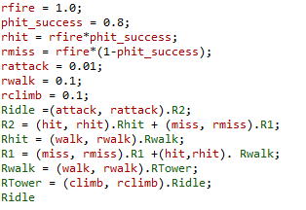
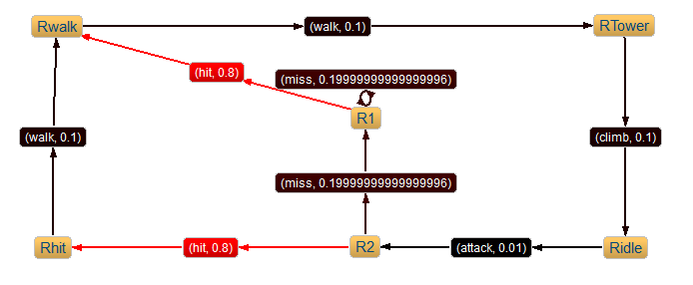
Case 1. Roland meets an Enemy

Slide 7
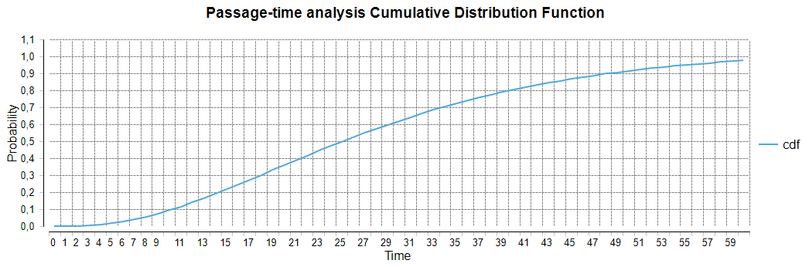
Case 1. Passage Time analysis
Passage-time analysis allows us to calculate measures such as the probability that Roland reached the Tower at a given time after he is attacked. This would involve calculating the probability that the model performs a climb action within the given time after performing an attack action. Source action is attack, target action is climb.

Slide 8

Case 2. Enemies fight back
In the previous model we described case when only Roland attack enemy.
We now consider a model in which the enemies will fight back.
However for now we still assume that they never seriously injure Roland.
This model can be used to calculate properties such as the likelihood that an enemy will manage to fire one shot before they are killed by Roland.
When Roland killed his enemy he can be arrested by chief Randall Flagg, but no one can arrest him in the Tower.
Once arrested he will escape from the prison and continue his journey to the Tower.
Enemies component is simplified: he will keep firing until Roland will kill him.

Slide 9
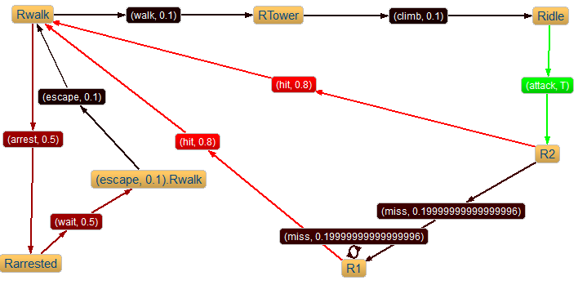
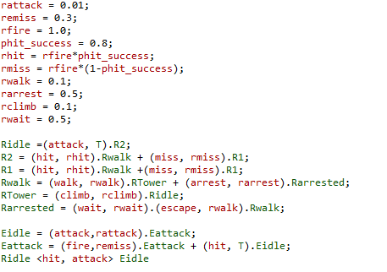
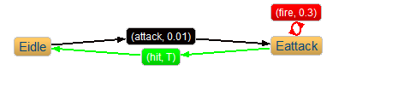
Case 2. Enemies fight back

Slide 10
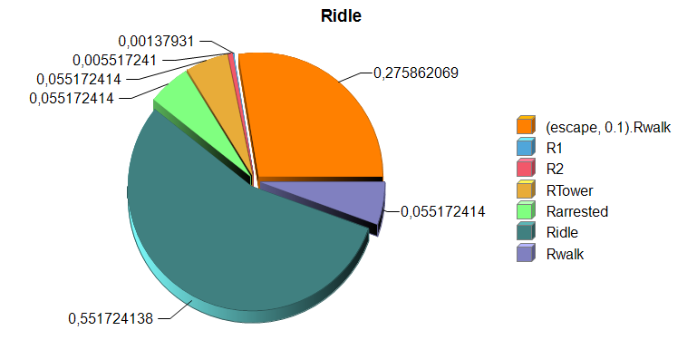
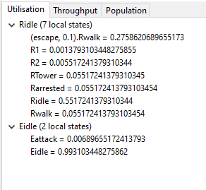
Case 2. Steady state analysis
The Utilisation Analysis tab is a tree-based view showing the percentage of time it is in a particular local state for each component.
Utilistation graph view for Roland component

Slide 11
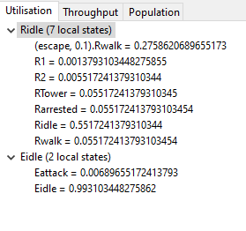
We can calculate the probability that at arbitrary time Roland reached the Tower and climbing based on the steady state probability.
The probability that Roland reached the tower is 5,5%. The probability that Roland involved in gun battle is R1+R2 = 0.7 % . Most of Time Roland is in peaceful state.
It make sense if we will highlight that according to the novel Roland is very old and presumed to be immortal. He is approximately 336 or 337 years old at the end of his quest

Slide 12
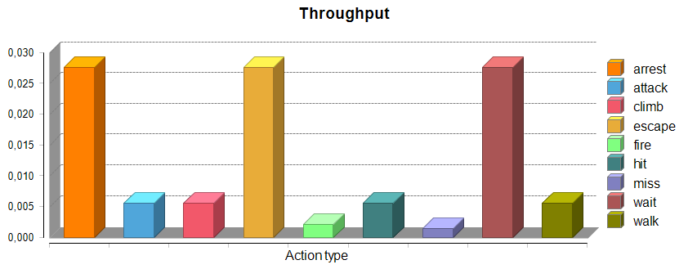
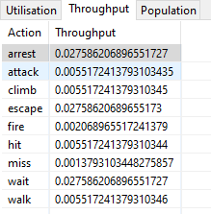
Rate-based measure throughput
Throughput - the probability of being in one of the states from which the event can occur.

Slide 13

Case 3. Roland makes a friend. Synchronizing
In this scenario cooperation is used to synchronize between components of the model such that they observe events which they neither directly cause nor are directly affected by. Whenever either Roland or the accomplice kills the enemy they stop firing at a dead opponent.
However we do not want to leave Roland vulnerable when there is no accomplice present while Roland involved in battle, because some of his actions become blocked. To prevent this we introduce a dummy component representing the absence of an accomplice. In this state the accomplice component will passively participate in any attack which Roland makes.
Enemy can hit the Accomplice.
After any battle his accomplice will leave him and Roland will continue his journey alone.

Slide 14
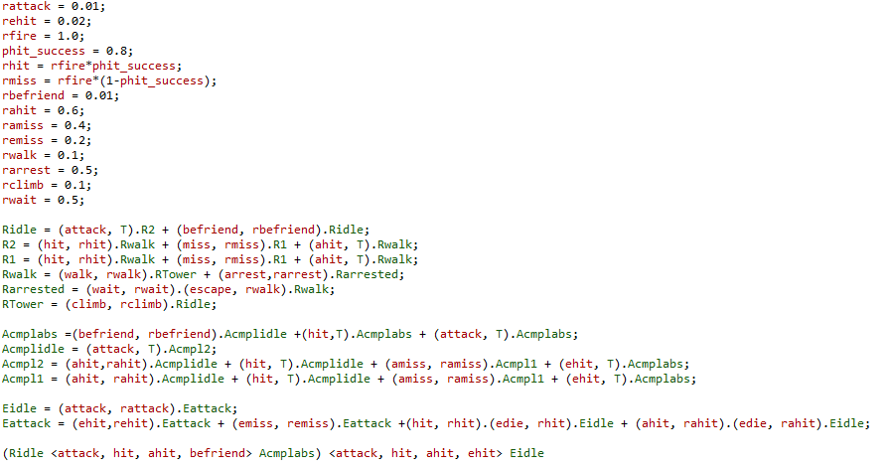
Case 5. Roland synchronize with a friend
Our system have a multi-way synchronization between Ridle and Acmplabs on the activity of types attack, hit, ahit, befriend and with Eidle on the activity of types attack, hit, ahit, ehit.

Slide 15
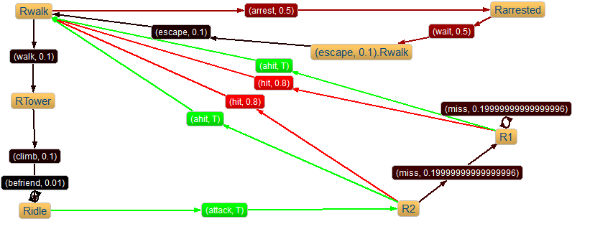
Case 3. Roland synchronize with a friend
Component Roland

Slide 16
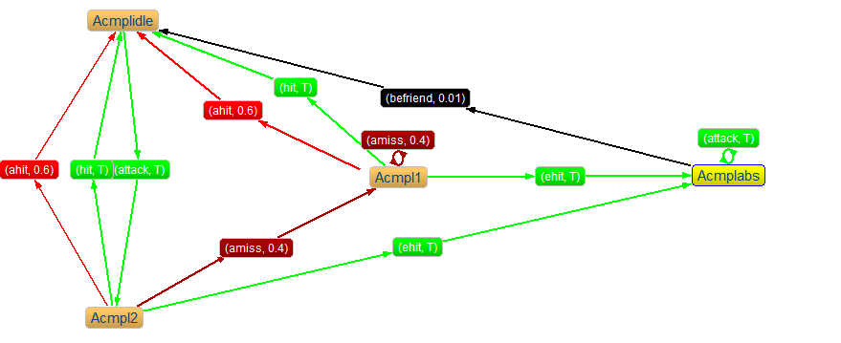
Case 3. Roland synchronize with a friend
Component Accomplice

Slide 17
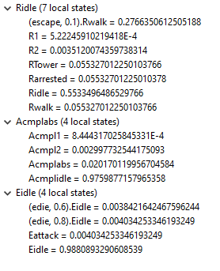
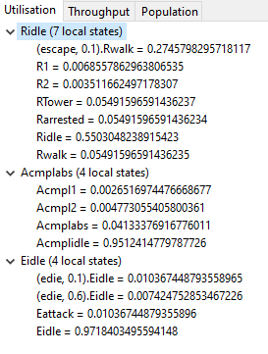
Case 3. Roland synchronize with a friend
As before we can determine the probability that Roland is involved in a gun battle and has an accomplice at an arbitrary time. Since Roland cannot perform a befriending action while currently involved in a battle, the probability that Roland is in such a battle clearly affects the probability that he is alone in his quest. For example, if Roland’s success rate is reduced, gun battles will take longer to resolve and Roland will be involved in a gun battle more often. Consequently he will befriend fewer accomplices.
When phit_success = 0.8
When phit_success = 0.1

Slide 18
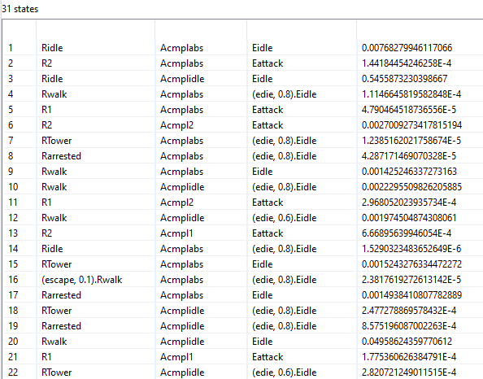
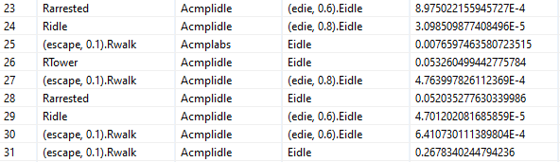
Once a model is successfully parsed, Markovian analysis can begin via state space derivation of the underlying Markov chain. The derivative set of a component P is the set of all PEPA components representing all the reachable states of the
system modeled by P.

Slide 19

Constructing and Solving Markov Processes
We chose first example Roland meets an Enemy to model and calculate the quantitative measures.

Slide 20


Generator matrix
For every time-homogeneous, finite, irreducible Markov process with state space S, there exists a steady state
probability distribution πk that the model is in state xk. Expressing the values i as a row vector , we can write this as a matrix equation:
Since πi is a probability distribution we also know that the normalization condition holds:
We will use column vector of πi, not a row vector, that is why we will transpose our matrix and use equation. We also replace last row of transposed matrix by 1’s. Similarly we change the solution vector, which was all zeros to be a column vector with 1 in the last row, and zeros everywhere else.

Slide 21
μ = rhit = 0.8;
λ = rmiss = 0.2;
a = rattack = 0.01;
b = rwalk = 0.1;
c = rclimb = 0.1.
 | R1 | R2 | RTower | Rhit | Ridle | Rwalk
R1 |  |  |  |  |  | μ
R2 | λ |  |  | μ
RTower |  |  |  |  | c
Rhit |  |  |  |  |  | b
Ridle |  | a
Rwalk |  |  | b
-μ | 0 | 0 | 0 | 0 | μ
λ | -(λ+μ) | 0 | μ | 0 | 0
0 | 0 | -c | 0 | c | 0
0 | 0 | 0 | -b | 0 | b
0 | a | 0 | 0 | -a | 0
0 | 0 | b | 0 | 0 | -b
-μ | λ | 0 | 0 | 0 | 0
0 | -(λ+μ) | 0 | 0 | a | 0
0 | 0 | -c | 0 | 0 | b
0 | μ | 0 | -b | 0 | 0
0 | 0 | c | 0 | -a | 0
1 | 1 | 1 | 1 | 1 | 1
Q =
=

Slide 22
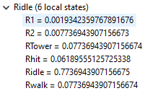
Generator matrix
-μ | λ | 0 | 0 | 0 | 0
0 | -(λ+μ) | 0 | 0 | a | 0
0 | 0 | -c | 0 | 0 | b
0 | μ | 0 | -b | 0 | 0
0 | 0 | c | 0 | -a | 0
1 | 1 | 1 | 1 | 1 | 1
π1
π2
π3
π4
π5
π6
0
0
0
0
0
1
*
=
- μ*π1 + λ*π2 = 0
-(λ+μ)*π2 + a*π5 = 0
-c*π3 + b*π6 = 0
μ*π2 – b*π5 = 0
c*π3 – a*π5 = 0
π1 + π2 + π3 + π4 + π5 + π6 = 1
π2 = 4 π1
π5 = 400 π1
π3 = π6
π4 = 32 π1
π3 = 40 π1
π1 + 4 π1 +40 π1 +32 π1 + 400 π1 + 40 π1 =1
π1 = 0.001934…

Slide 23
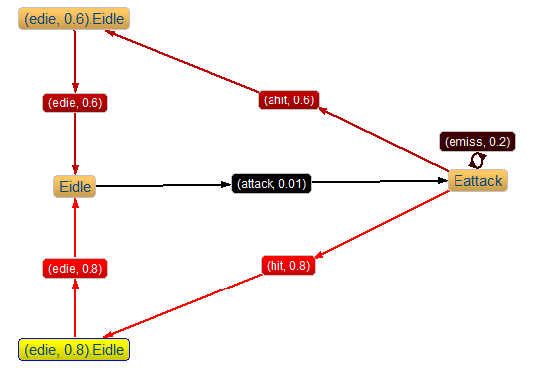
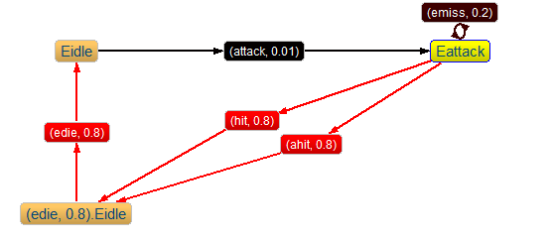
Lumpability
lumpability is a method for reducing the size of the state space of some continuous-time Markov chains. In order to explain this method, we take enemy sub-component of Case 3.

Slide 24
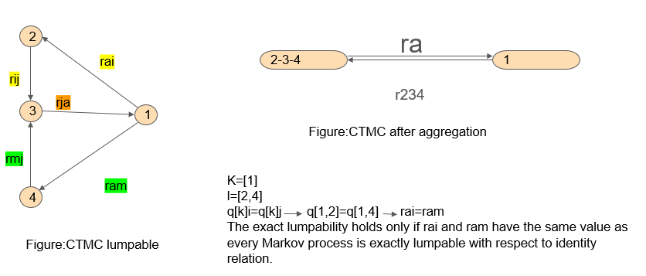
Lumpability
In our model Enemy can be killed by Roland with rate 0.8 or by his Accomplice with rate 0.6. Every time Enemy move from state Eattack to state Eidle by choosing between two active types and fastest one will be completed. If we will consider that Roland and his Accomplice have the same value of rate 0.8 we can reduce our model to simple one.

Slide 25

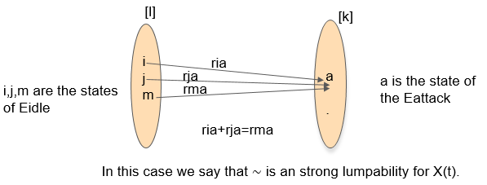
Strict lumpability
Probabilities of state 2, 3 and 4 are equal.
Probabilities of macro states[2 3 4] is equal to the sum of probabilities of 2,3 and 4.
Strong lumpability
A strongly lumpable partition exists if there is an equivalence relation over the state space such that for any two states within an equivalence class their aggregated transition rates to any other class are the same.

Slide 26
Conclusion
We demonstrated abstract representation of a system based on popular hero of The Dark Tower Series. During the presentation we conceptualized our system as a Markov chain, constructed an infinitesimal generator matrix Q, solved Markov chain automatically with PEPA Eclipse Plug-in and manually to derive quantitative information about our system.
The main conclusion we have made is the stochastic hypothesis: The behavior of a real system during a given period of time is characterized by the probability distributions of a stochastic process.

Slide 27
